Slide 1
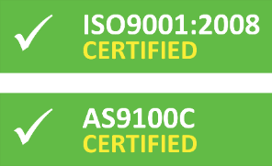
Creativity Session
Presenter’s Name

Slide 2
ABOUT NAPOLEON ENGINEERING SERVICES
Within one day’s travel, NES is able to reach 55% of the U.S. population, roughly 175.4 million people.
Established in 1997 by Chris Napoleon, President and Chief Engineer
Staff of 50 engineers, machinists, and administrative personnel
Olean

Slide 3
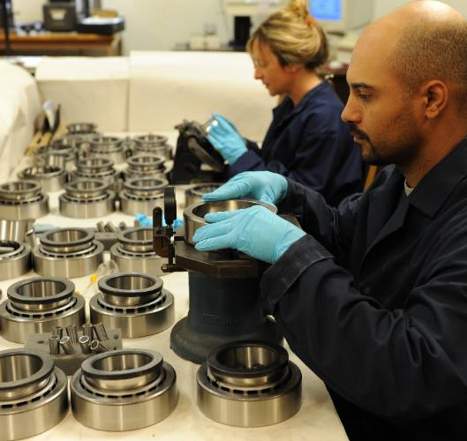
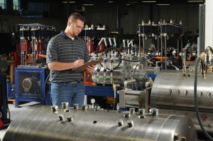
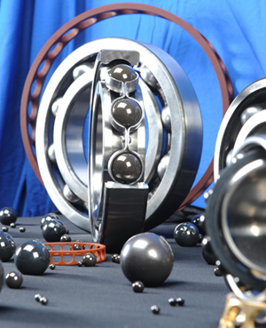
ONE-STOP SHOP BEARING SERVICES
Bearing Inspection
Bearing Testing
Custom Bearing Manufacturing

Slide 4
CUSTOMER BASE

Slide 5
CUSTOM BEARING MANUFACTURING

Slide 6
CUSTOM BEARING MANUFACTURING Mission Statement
Napoleon Engineering Services combines application experience and engineering knowledge to provide shorter lead times and cost effective solutions to custom bearing needs through complete bearing manufacturing.

Slide 7
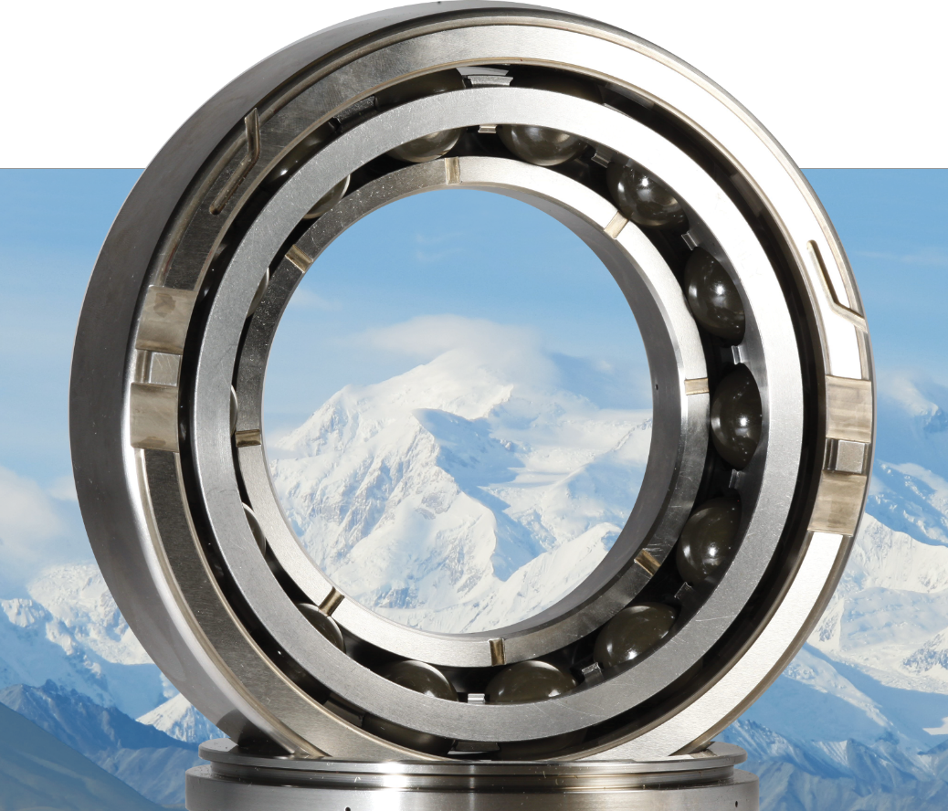
High Temperature, Corrosion Resistant, High Fatigue Life, and Dimensionally Unique Bearings
Short Lead Times
Small & Large Orders
Unique Materials
Application Engineering
Full Product Traceability
Made in the USA

Slide 8
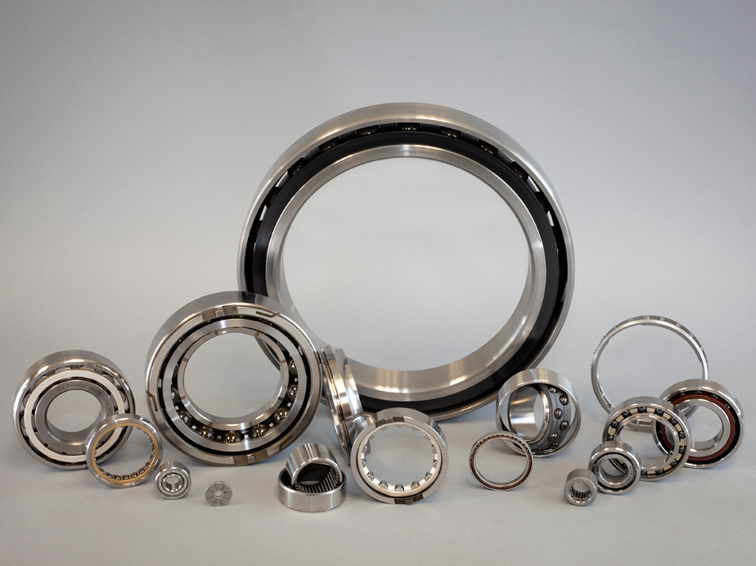
COMPLETE BEARING MANUFACTURING CAPABILITY
Size range
20mm through 350mm OD
Average lot size
25 to 50 pieces
Lot size capability up to 1000 pieces
Bearing types
DG and AC Ball Bearing
DR Self Aligning Ball Bearing
Cylindrical Roller Bearing
Needle Roller Bearing
Quality class
Up to ABEC/RBEC 9
Quality System
ISO 9001:2008
AS9100 Rev C

Slide 9
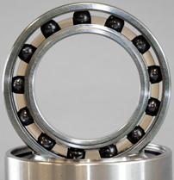
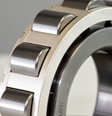
COMPLETE BEARING MANUFACTURING Typical Material Options
Ring Materials
52100
Rolling Elements
52100
Precision Cages
Bronze
M50
Pyrowear® 675
XD15NW
440C
440C
Silicon Nitride (Ceramic)
M50
Steel
Silver Plated Bronze or Steel
Nylon 6/6
PEEK
Vespel®
Torlon®
AMS 5898 (Cronidur® 30)
BG42
Nitinol 60
AMS 5898 (Cronidur® 30)
M50Nil

Slide 10
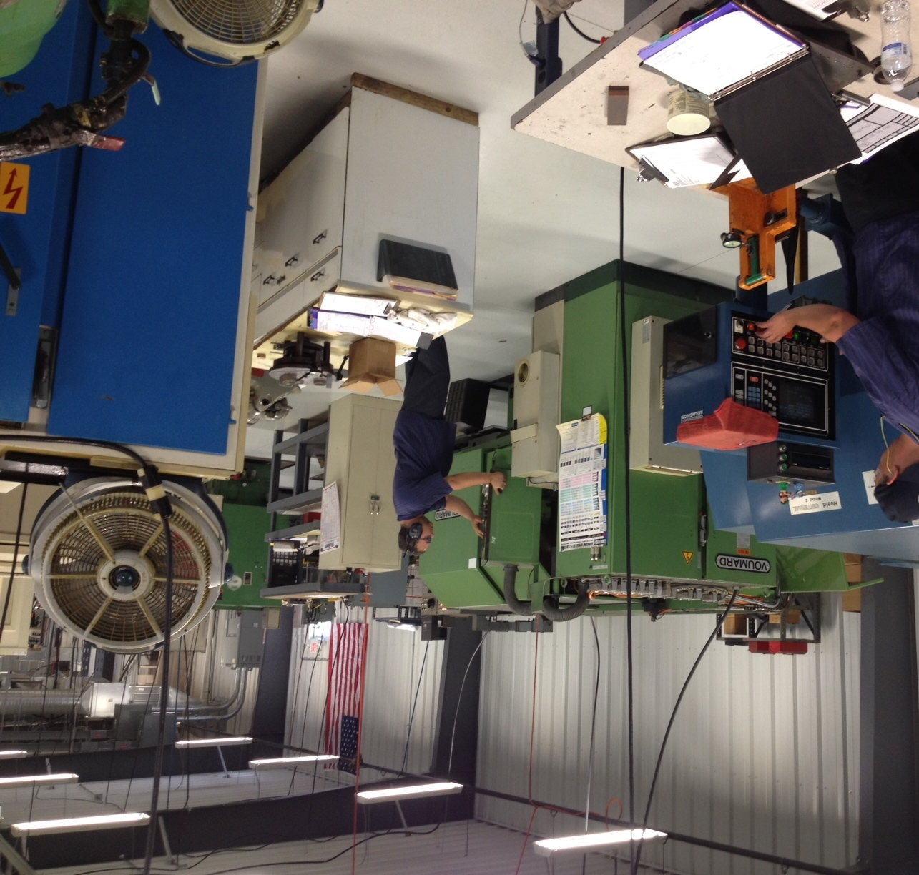
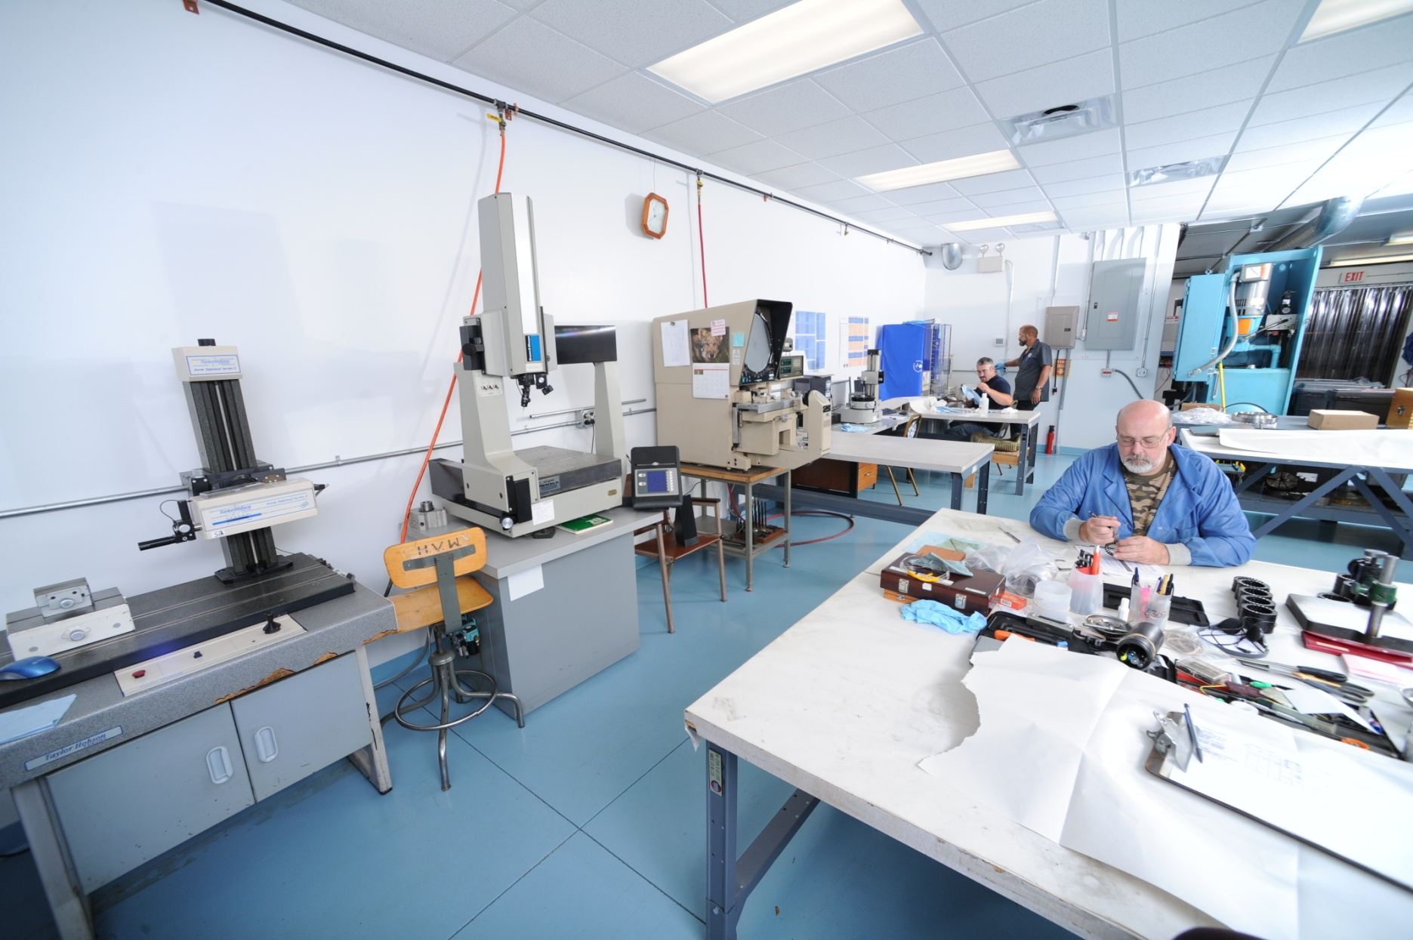
COMPLETE BEARING CHANNEL

Slide 11
BEARING INSPECTION & TESTING Largest Independent Facility in North America

Slide 12
BEARING INSPECTION & TESTING Mission Statement
Napoleon Engineering Services utilizes specific bearing expertise and equipment to develop valuable technical information in order for customers to make informed decisions about bearing and supplier performance.

Slide 13
BEARING INSPECTION Largest Independent Facility in North America

Slide 14
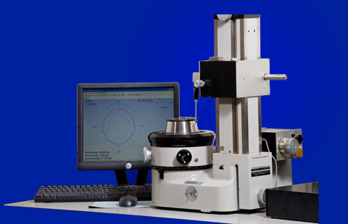
BEARING INSPECTION PMA Programs
(Parts Manufacturing Approval for FAA certification)
Aircraft Bearing Reverse Engineering Program
NES provides:
Physical evaluation of type certified aerospace product for reverse engineering
Detailed drawings and manufacturing data in support of FAA-PMA approval and subsequent manufacturing

Slide 15
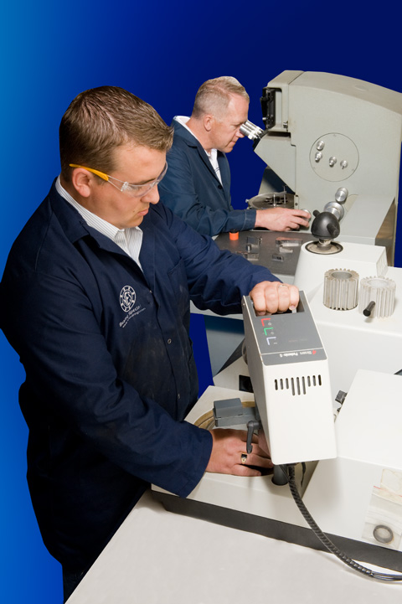
BEARING INSPECTION Material Evaluation and Testing
Material Integrity Tests
Material Composition
Microstructure
Grain Size
Material Cleanliness
Hardness
Microhardness
SEM/EDS
X-Ray Diffraction

Slide 16
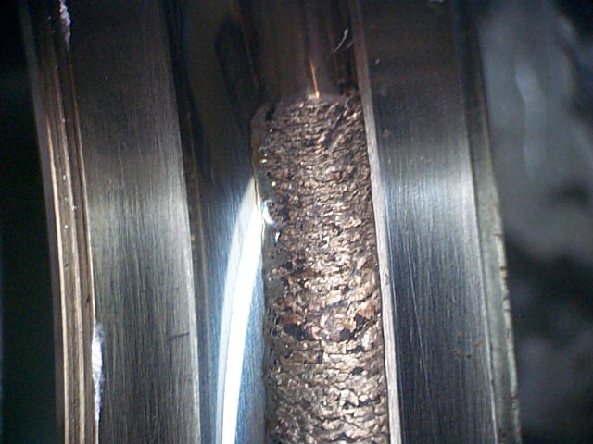
BEARING INSPECTION Failure Analysis-Condition Analysis
Supports examination of wear characteristics in new product development
Resolves issues associated with system design
Provides detailed report
Failure characteristics
Information to eliminate failure reoccurrence

Slide 17
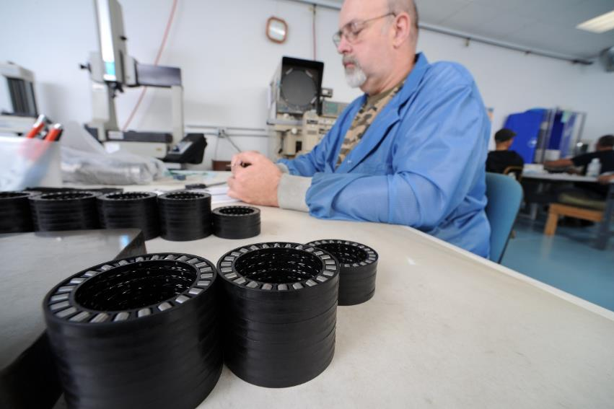
FIRST ARTICLE INSPECTION (FAI) PER AS9102
Verify bearing conforms to all engineering requirements.
Gain added confidence
Complete, independent, and documented FAI, including material and special process accountability.

Slide 18
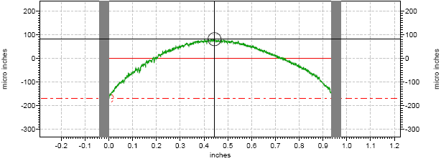
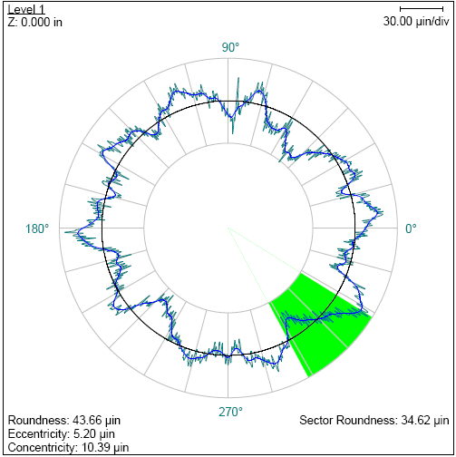
Bearing Inspection Source Qualification Inspection (SQI) Industrial Bearing Reverse Engineering Program
Goals of SQI
Define Design Intentions
Determine Manufacturing Capability
Evaluate Quality of Workmanship
Consists of:
Detailed Dimensional Analysis of Internal Geometries
Visual Inspection
Noise Testing
Seal Dimensional Evaluation
Material Chemistry, Microstructure, Grain Size, Cleanliness, and Hardness

Slide 19
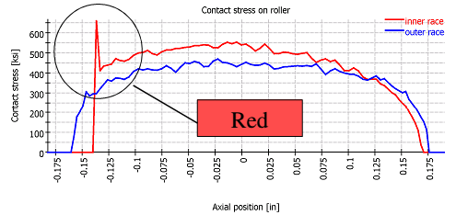
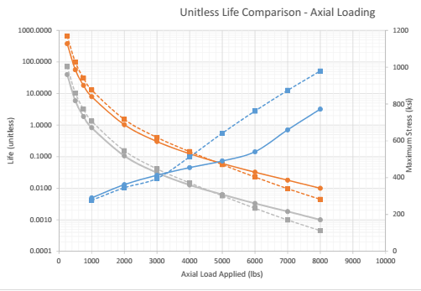
Modeling Benefits Translates inspection characteristics into potential operational performance

Slide 20
BEARING TESTING Largest Independent Facility in North America

Slide 21
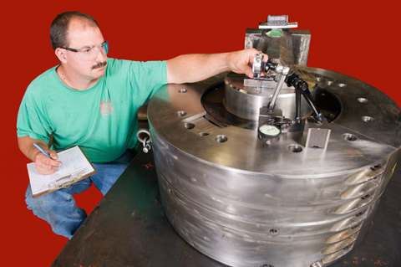
TESTING PROGRAMS
Test Types:
Environmental
Impact or Static Load
Dynamic

Slide 22
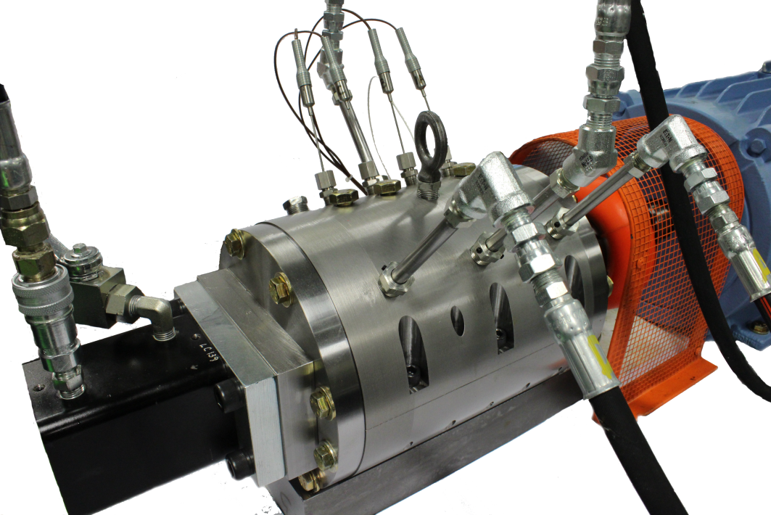
ENDURANCE/FATIGUE Component or Bearing Testing
Accelerated Life Testing to Evaluate:
Material Properties
Life Adjustment Factors
Heat Treat Variations
Designs
Manufacturing Quality
Lubrication
Running Characteristics

Slide 23
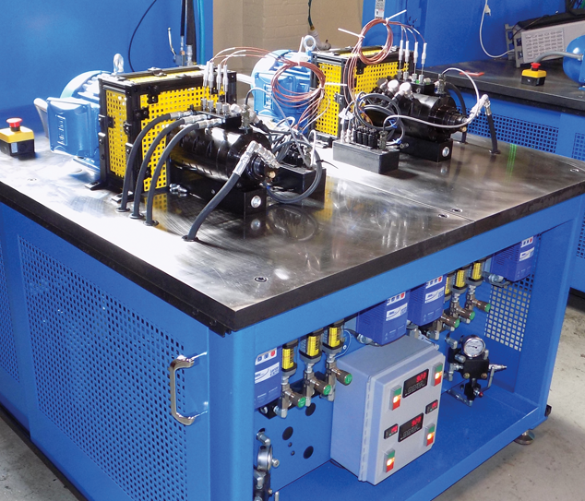
NES TEST RIGS
NES has over 50 endurance test rigs of different sizes and types to evaluate bearings within the size range of:
0.25in OD up to 30in OD

Slide 24
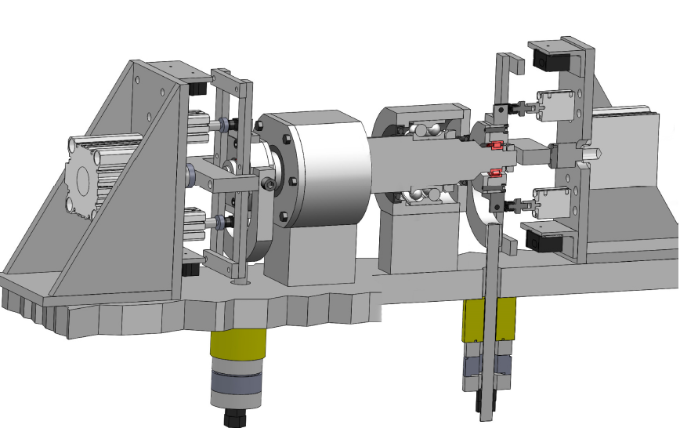
TEST RIG MANUFACTURING

Slide 25
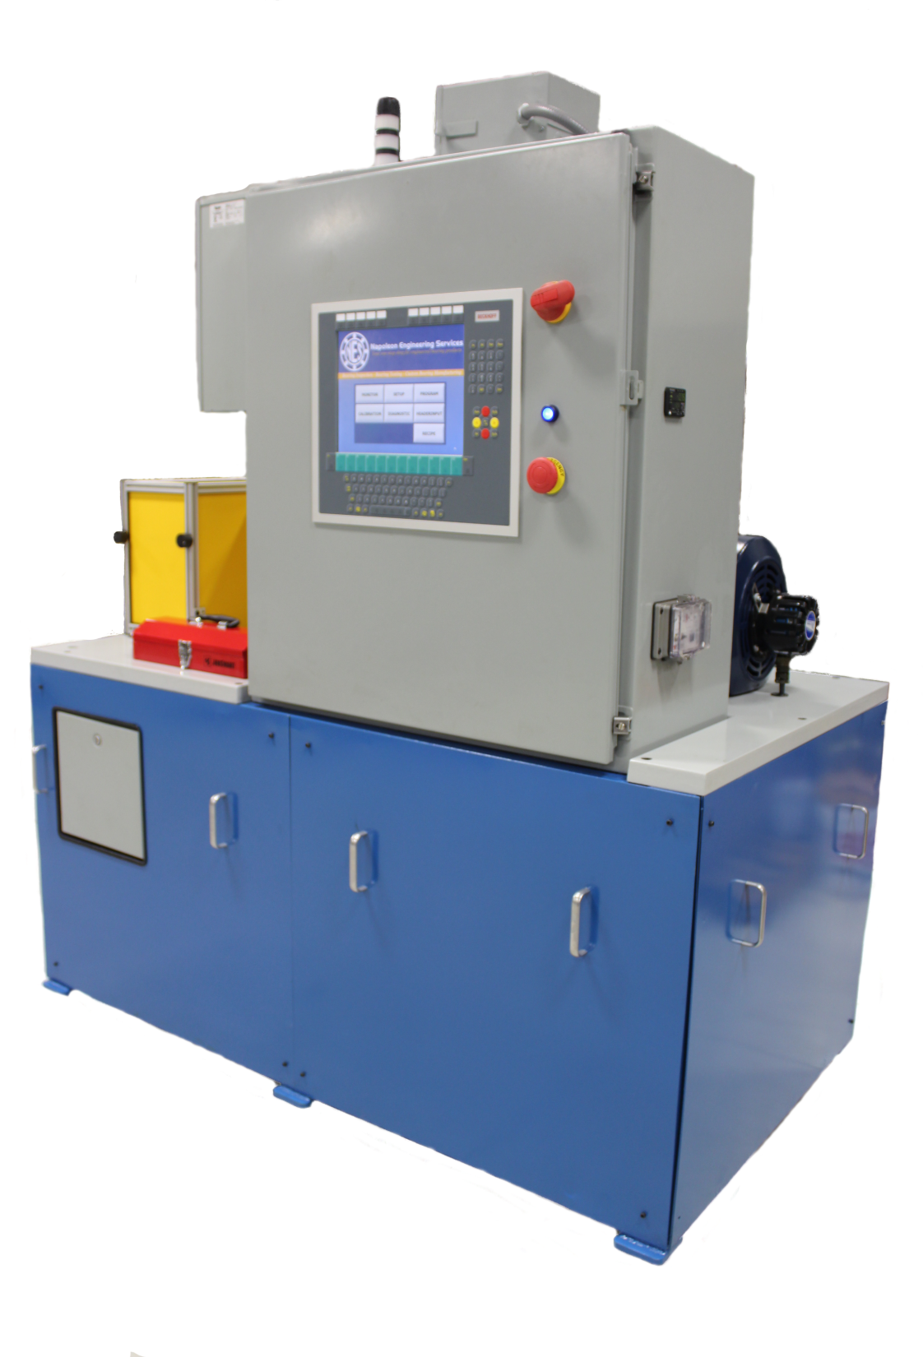
TEST RIG MANUFACTURING
Rigs are designed based on either standard bearing testing methods, simulated application conditions, or specific standards
Full PC-based controls for duty cycle testing where conditions are monitored and controlled to ensure consistent test conditions for accurate measurement
Also lower cost manual control systems for standard bearing testing

Slide 26
TEST PARAMETERS
Controlled
Radial Load
Axial Load
Rotational Speed
Bearing Temperature
Lubrication Temperature
Lubrication Flow
Monitored
Bearing Vibration
Bearing Temperature
Housing Displacement
Shaft Deflection
Bearing Torque

Slide 27
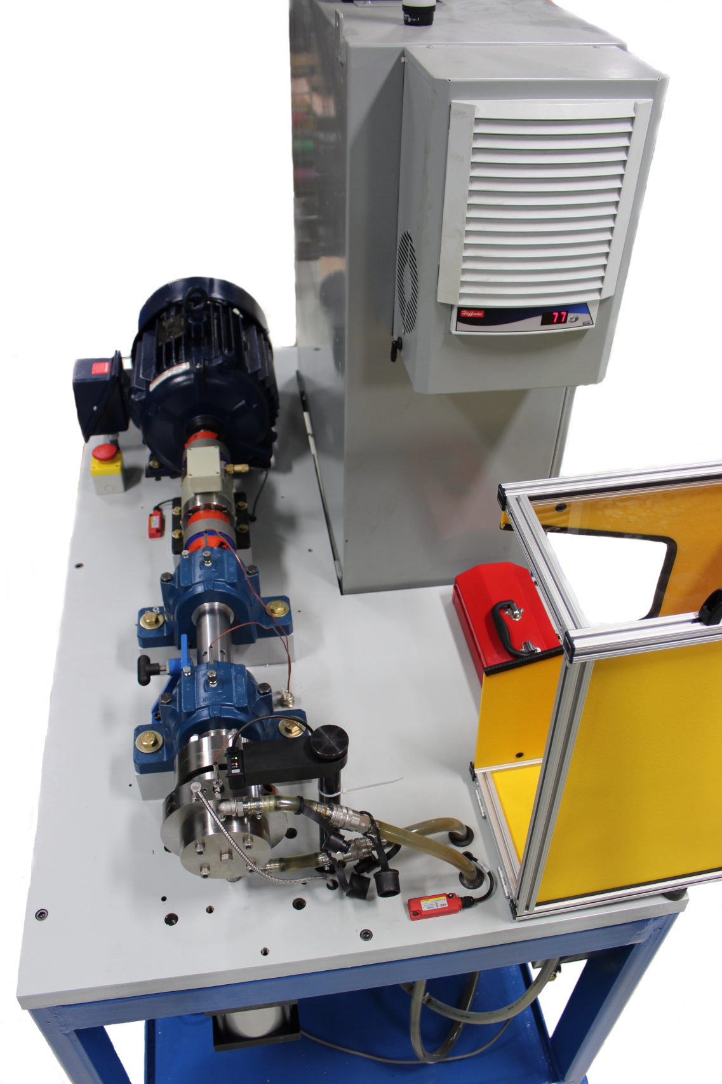

Slide 31
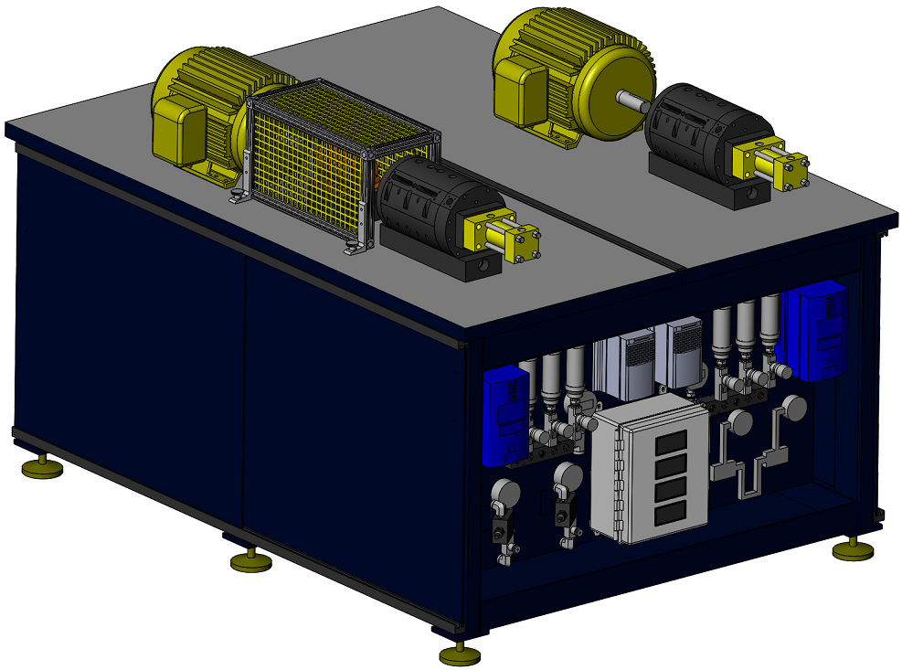

Slide 34
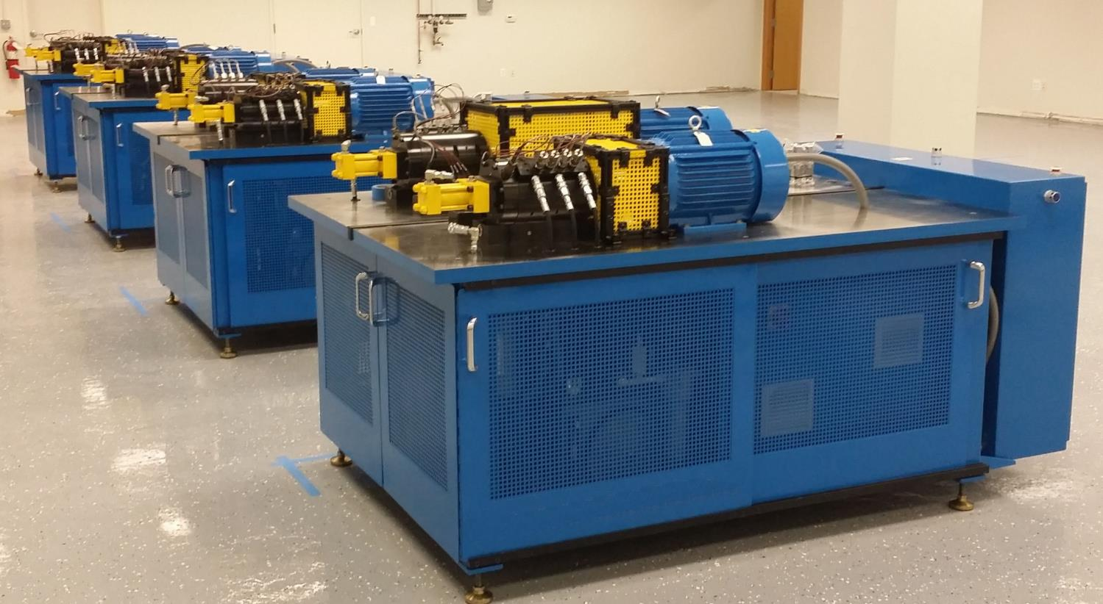

Slide 35
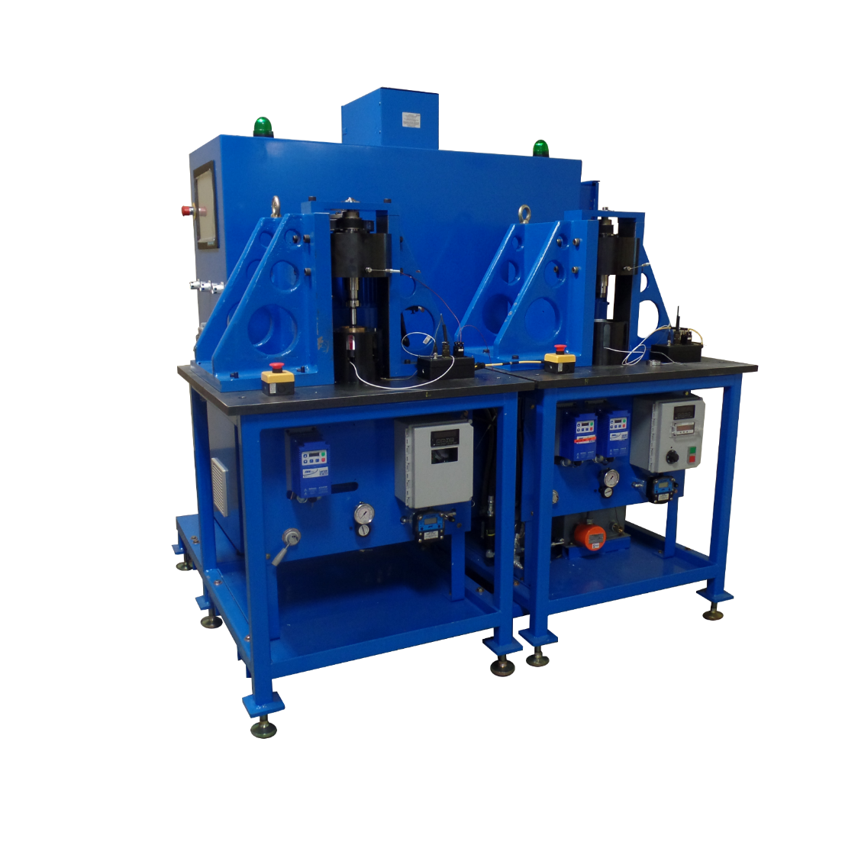

Slide 36
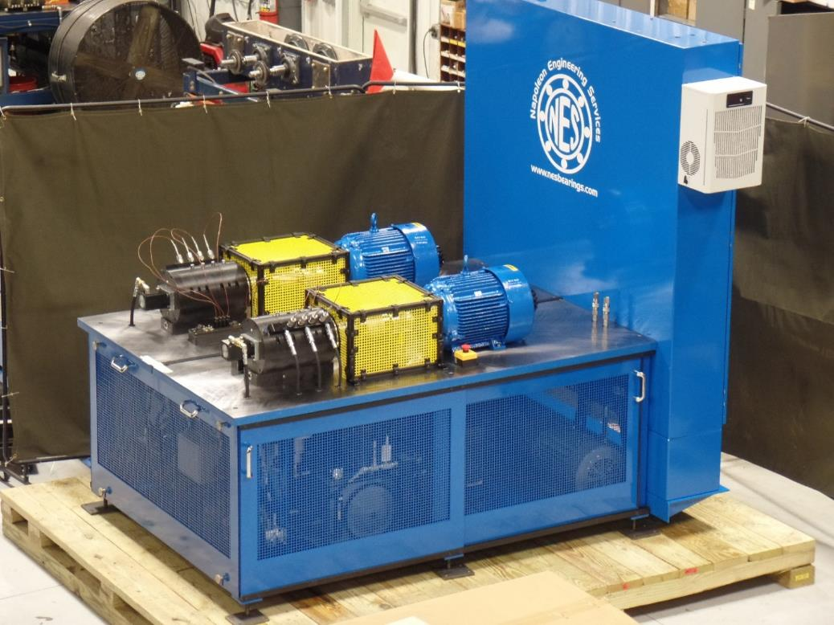
FULLY PROGRAMMABLE BEARING TEST RIG

Slide 37
THANK YOU FOR YOUR TIME (877) 870-3200 www.nesbearings.com

